Slide 1


Data Visualization with Excel

Slide 2
Course Overview & Expectations
This course focuses on data visualization techniques using Microsoft Excel, equipping students with the skills to create clear, effective, and interactive visualizations. Students will learn how to choose the right charts, create Pivot Charts, use Slicers & Timelines, and design dynamic dashboards to extract insights from data.
By the end of this course, students will be able to:
    ✅ Understand the fundamentals of data visualization and best practices.
    ✅ Identify the right chart type based on different data scenarios.
    ✅ Create basic and advanced charts in Excel.
    ✅ Use Pivot Charts to summarize large datasets dynamically.
    ✅ Add interactivity to dashboards using Slicers & Timelines.
    ✅ Build professional, data-driven reports and dashboards in Excel.

Slide 3
Topic 1: Getting Started with Visualization in Excel
What is Data Visualization?
Data Visualization is the process of representing data graphically to make information easier to understand, analyze, and interpret. It involves using charts, graphs, maps, and dashboards to transform raw data into meaningful insights.
Simply put: Instead of looking at thousands of numbers in a spreadsheet, we use visual elements like bars, lines, and colors to see trends and patterns at a glance.

Slide 4
Topic 1: Getting Started with Visualization in Excel
Why is Data Visualization Important?
  Simplifies complex data – Large datasets can be overwhelming when presented as raw numbers. Visualization helps break them down into clear and understandable charts or graphs, making it easier to interpret key information.
  Identifies trends and patterns – Visual representations, such as line charts and bar graphs, allow us to quickly see trends over time, seasonality, or patterns in data that might not be obvious in tables. For example, a sales trend chart can show revenue growth or decline over months.
  Highlights outliers and anomalies – Some data points may not fit expected trends. Visualization makes it easy to spot these outliers, which could indicate errors, fraud, or unique business opportunities. For instance, if a store’s sales suddenly spike or drop, a graph will immediately reveal this.

Slide 5
Topic 1: Getting Started with Visualization in Excel
Why is Data Visualization Important?
  Enhances decision-making – Business leaders, analysts, and decision-makers rely on clear insights to take action. Well-designed visualizations help them quickly understand key metrics and trends, leading to better, data-driven decisions.
  Improves communication – Charts, graphs, and dashboards make it easier to share findings with teams, clients, or executives. Instead of lengthy reports full of numbers, a single well-designed visualization can effectively summarize key points.
  Saves time – Analyzing thousands of rows in a spreadsheet can take hours. A simple chart can summarize the same information in seconds, helping analysts and businesses work more efficiently.
  Engages the audience – People process visuals faster than text or numbers. A well-designed dashboard with clear charts and graphs captures attention, making presentations and reports more engaging and persuasive..

Slide 6
Topic 1: Getting Started with Visualization in Excel
Principles of a Good Data Visualization
Creating effective visualizations requires following certain principles to ensure clarity, accuracy, and impact. Below are key principles to keep in mind:
Clarity – Keep It Simple & Easy to Understand
  A good visualization should communicate insights instantly without requiring too much effort to interpret.
  Avoid unnecessary decorations, complex designs, or excessive colors that may distract from the data.
  Use clear labels, titles, and legends to guide the audience in understanding the chart.

Slide 7
Topic 1: Getting Started with Visualization in Excel
Principles of a Good Data Visualization
2. Accuracy – Represent Data Truthfully
  Always use the right chart type to prevent misinterpretation. For example, a pie chart should only be used when the data represents parts of a whole.
  Ensure that axes and scales are consistent to avoid misleading conclusions (e.g., avoid truncating the Y-axis in bar charts, as it can distort comparisons).
  Avoid adding unnecessary 3D effects, as they can make it difficult to read accurate values..

Slide 8
Topic 1: Getting Started with Visualization in Excel
Principles of a Good Data Visualization
3. Relevance – Focus on Key Insights
  Only include data that is relevant to the audience and the purpose of the visualization.
  Remove extra details that do not add value. Too much information in one chart can cause information overload.
  Ensure that the visualization answers a key question or tells a meaningful story.

Slide 9
Topic 1: Getting Started with Visualization in Excel
Principles of a Good Data Visualization
4. Proper Chart Selection – Use the Right Type of Visualization
Choose the most appropriate chart type based on the type of data:
  Bar Chart – Best for comparisons (e.g., sales performance by region).
  Line Chart – Ideal for trends over time (e.g., revenue growth over months).
  Pie Chart – Used for proportions (but avoid if there are too many categories).
  Scatter Plot – Good for showing relationships between two variables.
  Pivot Charts – Great for dynamic data analysis and filtering..

Slide 10
Topic 1: Getting Started with Visualization in Excel
Principles of a Good Data Visualization
5. Use of Colors Wisely
  Colors should enhance readability, not cause confusion.
  Use contrasting colors for different categories but avoid using too many colors in one chart.
  Maintain consistency in color coding (e.g., using the same color for the same product category across different charts).
  Be mindful of color blindness—use accessible color schemes.

Slide 11
Topic 1: Getting Started with Visualization in Excel
Principles of a Good Data Visualization
6. Labels, Titles, and Legends – Ensure Readability
  Every chart should have a clear and descriptive title that explains what the visualization represents.
  Use data labels and axis labels to make the chart easy to understand.
  If using multiple categories, include a legend to clarify what each color or line represents.
7. Interactivity (For Dashboards & Pivot Charts)
  If creating dashboards in Excel, add interactive elements like slicers, filters, or drop-downs to allow users to explore data dynamically.
  Pivot Charts are useful because they update automatically when data changes, making them ideal for real-time insights.

Slide 12
Topic 2: Creating Charts in Excel
Charts help visualize data in a meaningful way, making it easier to analyze trends, patterns, and relationships. Before creating a chart, it's crucial to choose the right chart type based on the data you want to represent.

Slide 13
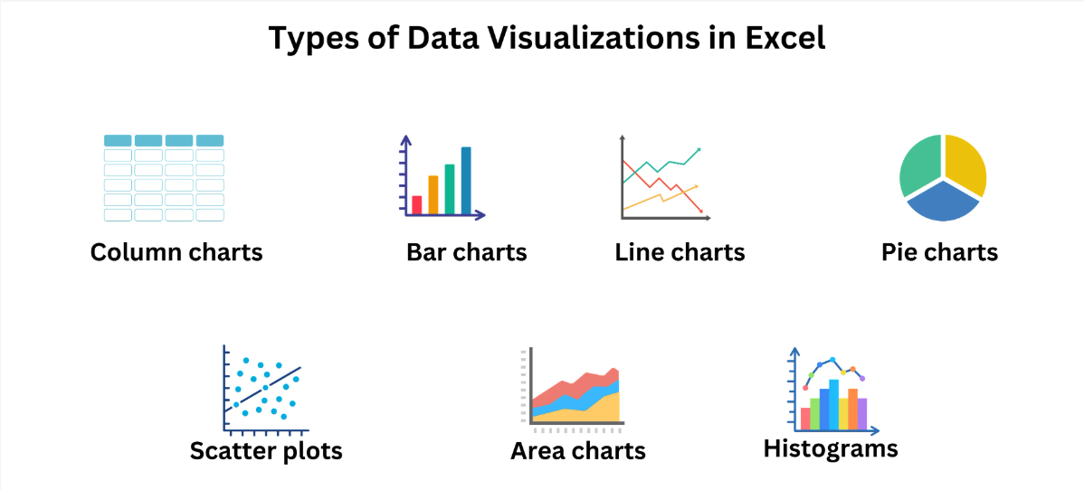
Topic 2: Creating Charts in Excel

Slide 14
Topic 2: Creating Charts in Excel
Choosing the Right Chart for Your Data
Different types of charts serve different purposes. Below are the most common Excel charts and when to use them.
1. Column & Bar Charts (For Comparisons)
  Use when you want to compare values across different categories.
  Best for sales reports, performance analysis, and categorical comparisons.
  Example: Comparing sales revenue across different regions.
Column Chart: Uses vertical bars to compare values.
Bar Chart: Uses horizontal bars (better for long category names).
How to create in Excel:
Select your data (e.g., product categories and sales figures).
Go to Insert → Column or Bar Chart → Choose your preferred style.

Slide 15
Topic 2: Creating Charts in Excel
Choosing the Right Chart for Your Data
2. Line Chart (For Trends Over Time)
  Use when you want to show trends, growth, or decline over a period.
  Best for financial reports, stock prices, temperature changes, and time-series data.
  Example: Tracking monthly revenue growth over a year.
How to create in Excel:
Select your data (e.g., months and sales figures).
Go to Insert → Line Chart → Choose a simple or smooth line chart.

Slide 16
Topic 2: Creating Charts in Excel
Choosing the Right Chart for Your Data
3. Pie Chart (For Proportions & Percentages)
    Use when you need to show how different categories contribute to a whole.
    Best for showing market share, budget distribution, or percentage-based analysis.
    Example: Showing the percentage of total sales per product category.
Limitations:
  Avoid using a pie chart if you have too many categories (more than five).
  Use labels or data percentages to improve readability.
How to create in Excel:
Select your data (e.g., product names and their percentage share).
Go to Insert → Pie Chart → Choose from 2D or 3D options.

Slide 17
Topic 2: Creating Charts in Excel
Choosing the Right Chart for Your Data
4. Scatter Plot (For Relationships Between Variables)
    Use when you want to analyze the relationship or correlation between two variables.
    Best for showing trends in data like price vs. sales, age vs. income, etc.
    Example: Checking if higher advertising spending leads to increased sales.
How to create in Excel:
Select your data (X and Y values).
Go to Insert → Scatter Chart → Choose a scatter plot.

Slide 18
Topic 2: Creating Charts in Excel
Choosing the Right Chart for Your Data
5. Pivot Chart (For Dynamic Data Analysis)
  Use when you need an interactive and flexible chart that updates as you filter data.
  Best for analyzing large datasets, creating dashboards, and summarizing trends.
  Example: Creating an interactive sales report where users can filter by region, product, or time.
How to create in Excel:
Select your Pivot Table.
Go to Insert → Pivot Chart → Choose your preferred chart type.

Slide 19
Topic 2: Creating Charts in Excel
Choosing the Right Chart for Your Data
Chart Type | Best For | Example Use Case
Column/Bar Chart | Comparing categories | Sales by region
Line Chart | Trends over time | Monthly revenue trends
Pie Chart | Showing proportions | Market share by product
Scatter Plot | Relationship between variables | Advertising spend vs. Sales
Pivot Chart | Interactive & dynamic analysis | Customizable reports

Slide 20
Topic 2: Interactive Dashboards in Excel
Introduction to Interactive Dashboards
An interactive dashboard is a dynamic and visually appealing report that allows users to explore data through filters, slicers, and dynamic charts. Dashboards help in decision-making by summarizing large datasets into meaningful insights.
Why Use Dashboards?
  Provides a clear summary of key data points.
  Enables real-time interaction through filters and slicers.
  Helps in decision-making by revealing trends and patterns.
  Saves time by allowing quick data exploration without needing multiple reports.

Slide 21
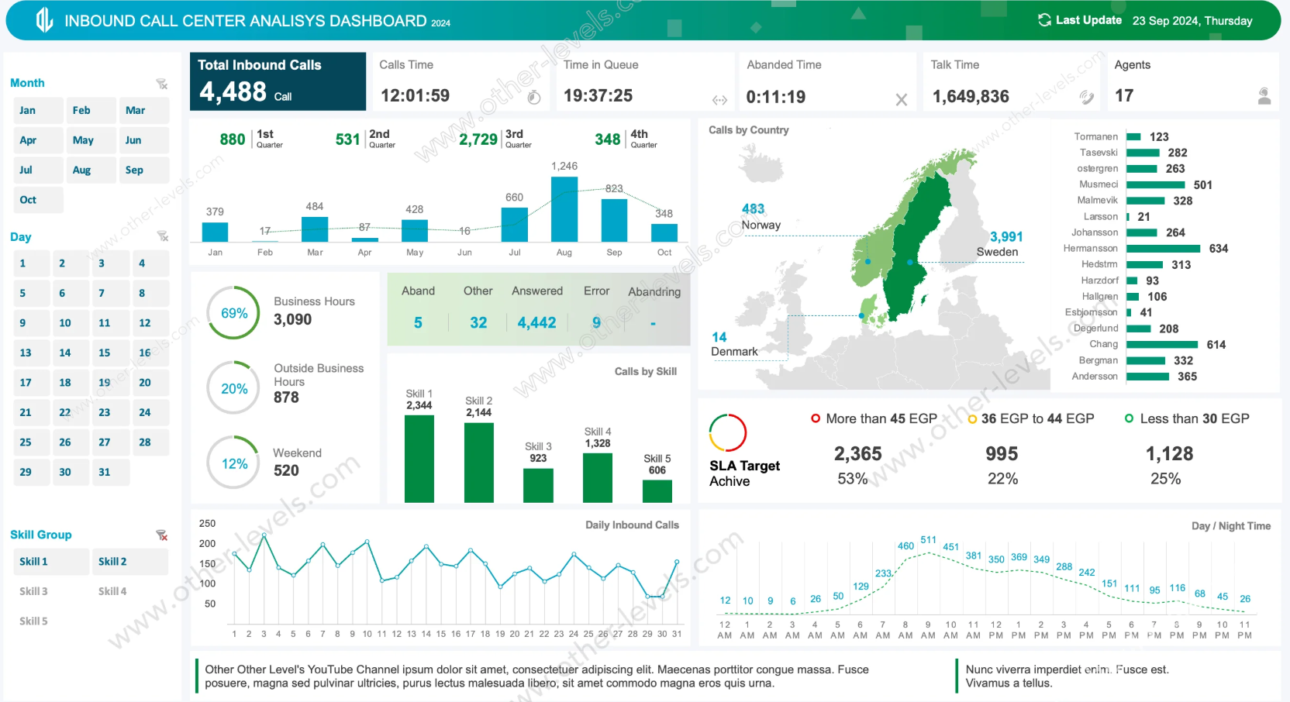
Topic 2: Interactive Dashboards in Excel

Slide 22
Topic 2: Interactive Dashboards in Excel
2. Key Components of an Interactive Dashboard
An effective dashboard should include the following elements:
a) Pivot Tables
  Used to summarize and analyze large amounts of data.
  Helps to create aggregated summaries like total sales, average revenue, etc.
b) Pivot Charts
  Dynamic charts that update automatically when filters are applied.
  Can display trends, comparisons, and distributions based on Pivot Table data.
  c) Slicers

Slide 23
Topic 2: Interactive Dashboards in Excel
2. Key Components of an Interactive Dashboard
An effective dashboard should include the following elements:
c) Slicers
  Interactive buttons that allow users to filter data quickly.
  Can be applied to Pivot Tables and Pivot Charts for dynamic filtering.
d) Timelines
  A special type of slicer used to filter data by date range.
  Best used for time-based data analysis, such as sales trends over months.

Slide 24
Topic 2: Interactive Dashboards in Excel
2. Key Components of an Interactive Dashboard
An effective dashboard should include the following elements:
e) Conditional Formatting
  Used to highlight important values using color codes or data bars.
  Helps users spot trends, outliers, and performance metrics easily.

Slide 25
Topic 3: Creating an Interactive Dashboard in Excel
Step 1: Prepare the Data
  Ensure your dataset is well-structured (no merged cells, blank rows, or inconsistent formats).
  Convert the dataset into a table by selecting it and pressing Ctrl + T.
Step 2: Create Pivot Tables
  Select your dataset.
  Go to Insert → Pivot Table → Choose "New Worksheet."
  Drag necessary fields into the Rows, Columns, and Values sections to generate summaries.

Slide 26
Topic 3: Creating an Interactive Dashboard in Excel
Step 3: Insert Pivot Charts
  Click inside the Pivot Table.
  Go to Insert → Pivot Chart → Choose a suitable chart type.
  Place the chart in a separate dashboard worksheet.
Step 4: Add Slicers
  Select any Pivot Table.
  Go to Insert → Slicer → Select fields you want to filter (e.g., Product, Region).
  Resize and move the slicers to a convenient position on the dashboard.
Step 5: Add a Timeline
  Click inside the Pivot Table.
  Go to Insert → Timeline → Select a date-based field (e.g., Order Date).
  Resize and format the timeline for a clean look.

Slide 27
Topic 3: Creating an Interactive Dashboard in Excel
Step 6: Apply Conditional Formatting
    Select the relevant data in your Pivot Table.
    Go to Home → Conditional Formatting → Choose Data Bars, Color Scales, or Icon Sets.
    Adjust the formatting rules to highlight key trends.
Step 7: Final Formatting & Layout
    Remove unnecessary gridlines for a cleaner look.
    Use consistent colors for charts and slicers.
    Align charts and slicers properly to make the dashboard visually appealing.

Slide 28
Practical Guide to Create an Interactive Sales Dashboard in Excel
1. Setting Up the Dataset
Step 1: Download & Open the Dataset
Download the dataset: Sales Dataset
Open it in Excel.
Ensure the data is structured properly (no merged cells or blank rows).
Step 2: Convert the Data into an Excel Table
Select any cell in the dataset.
Press Ctrl + T to create a table.
In the popup, check "My table has headers" and click OK.
Rename the table to SalesData for easy reference:
  Go to Table Design → Table Name → Enter SalesData.

Slide 29
Practical Guide to Create an Interactive Sales Dashboard in Excel
2. Creating Pivot Tables for Data Analysis
Step 3: Insert a Pivot Table
  Select any cell in the table.
  Go to Insert → PivotTable → From Table/Range.
  Choose New Worksheet and click OK.

Slide 30
Practical Guide to Create an Interactive Sales Dashboard in Excel
2. Creating Pivot Tables for Data Analysis
Step 4: Build Pivot Tables
a) Total Sales by Product Category
    Drag Product Category to Rows.
    Drag Sales Amount to Values (shows total sales per category).
b) Total Sales by Region
    Create another Pivot Table.
    Drag Region to Rows.
    Drag Sales Amount to Values.
c) Monthly Sales Trend
    Create a new Pivot Table.
    Drag Order Date to Rows → Right-click → Group by "Months".
    Drag Sales Amount to Values.

Slide 31
Practical Guide to Create an Interactive Sales Dashboard in Excel
3. Creating Pivot Charts for Visualization
Step 5: Insert Pivot Charts
  Click inside the first Pivot Table (Sales by Category).
  Go to Insert → Column Chart → Choose Clustered Column.
  Move the chart to the Dashboard sheet.
  Repeat for Sales by Region and Monthly Sales Trend (use a Line Chart).

Slide 32
Practical Guide to Create an Interactive Sales Dashboard in Excel
3. Creating Pivot Charts for Visualization
Step 5: Insert Pivot Charts
  Click inside the first Pivot Table (Sales by Category).
  Go to Insert → Column Chart → Choose Clustered Column.
  Move the chart to the Dashboard sheet.
  Repeat for Sales by Region and Monthly Sales Trend (use a Line Chart).

Slide 33
Practical Guide to Create an Interactive Sales Dashboard in Excel
4. Adding Interactivity with Slicers and Timelines
Step 6: Insert Slicers for Filtering
    Click inside any Pivot Table.
    Go to Insert → Slicer.
    Select fields:
      Product Category
      Region
    Click OK, resize, and move them to the Dashboard sheet.
Step 7: Insert a Timeline for Date Filtering
    Click inside the Monthly Sales Trend Pivot Table.
    Go to Insert → Timeline.
    Select Order Date and click OK.
    Resize and position it on the Dashboard sheet.

Slide 34
Practical Guide to Create an Interactive Sales Dashboard in Excel
4. Adding Interactivity with Slicers and Timelines
Step 6: Insert Slicers for Filtering
    Click inside any Pivot Table.
    Go to Insert → Slicer.
    Select fields:
      Product Category
      Region
    Click OK, resize, and move them to the Dashboard sheet.
Step 7: Insert a Timeline for Date Filtering
    Click inside the Monthly Sales Trend Pivot Table.
    Go to Insert → Timeline.
    Select Order Date and click OK.
    Resize and position it on the Dashboard sheet.

Slide 35
Practical Guide to Create an Interactive Sales Dashboard in Excel
5. Applying Conditional Formatting
Step 8: Highlighting Top Performers
    Select Sales Amount in the Pivot Table.
    Go to Home → Conditional Formatting.
    Choose Data Bars or Color Scales to highlight high/low sales values.

Slide 36
Practical Guide to Create an Interactive Sales Dashboard in Excel
6. Final Touches for a Professional Dashboard
Step 9: Formatting and Layout
    Remove Gridlines: Go to View → Uncheck Gridlines.
    Add a Dashboard Title: Insert a Text Box with “Sales Dashboard”.
    Align Charts & Slicers: Ensure everything is neatly arranged.

Slide 37
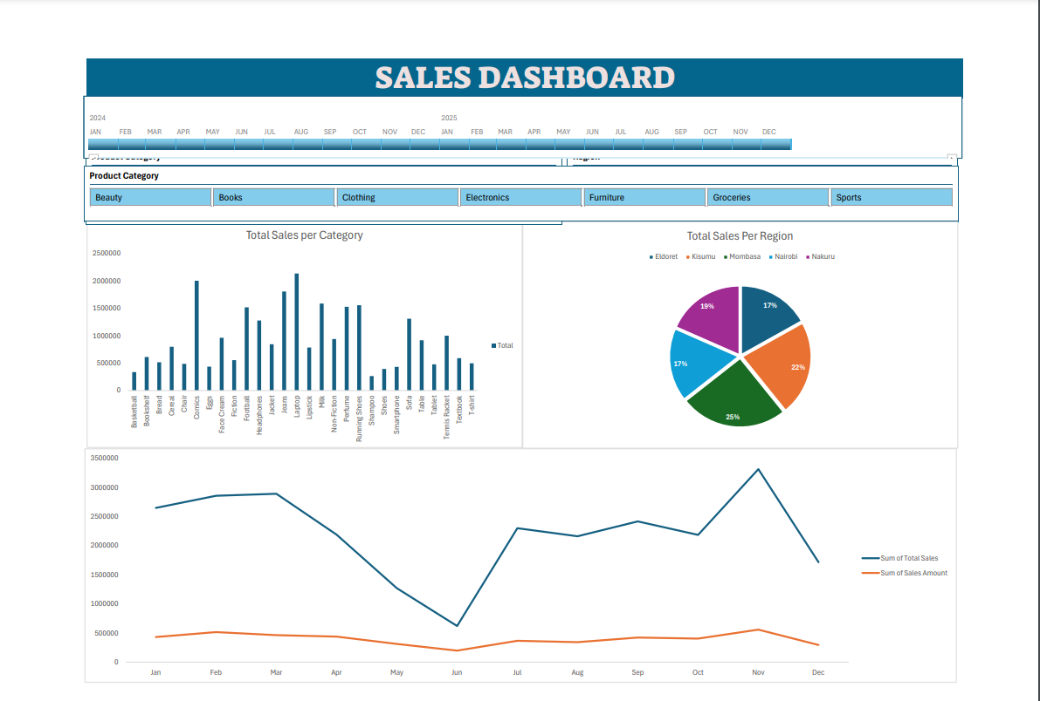
Practical Guide to Create an Interactive Sales Dashboard in Excel

